Slide 1
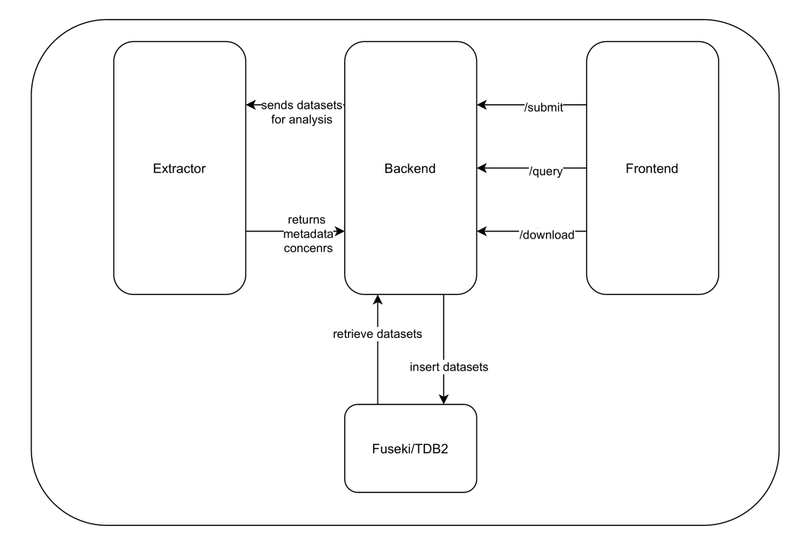
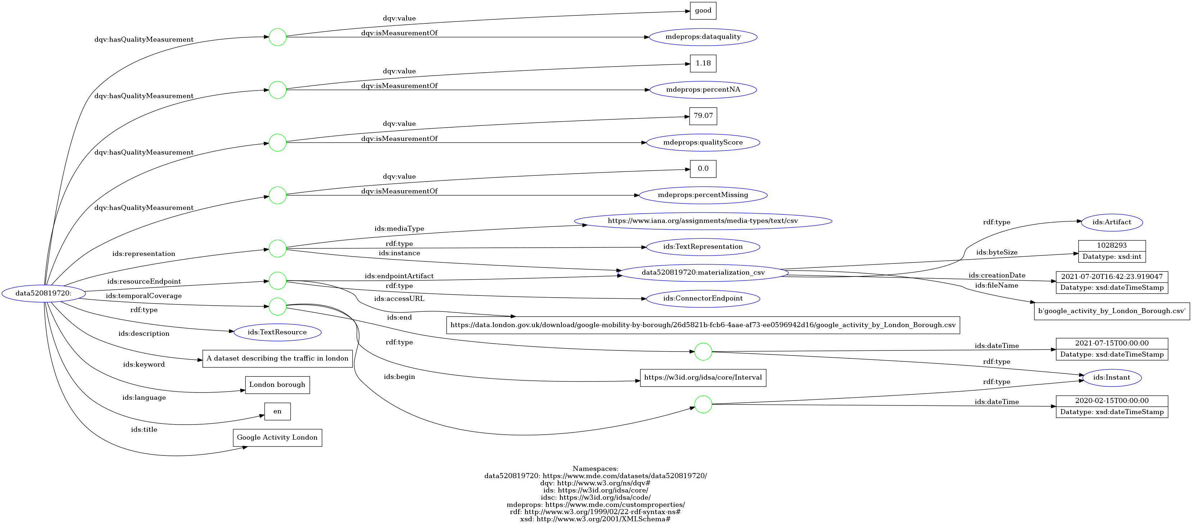
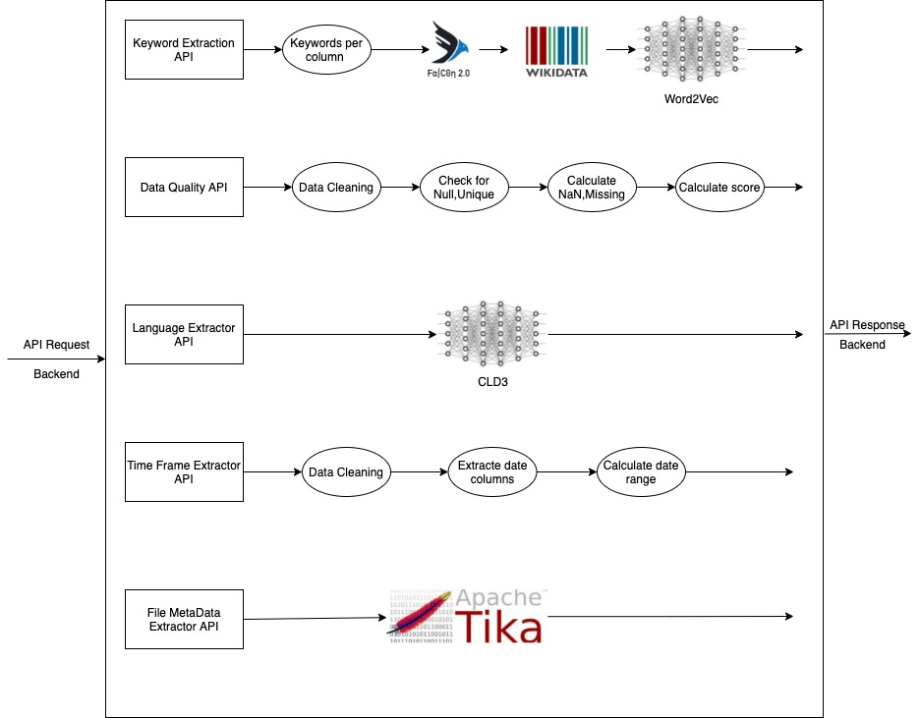
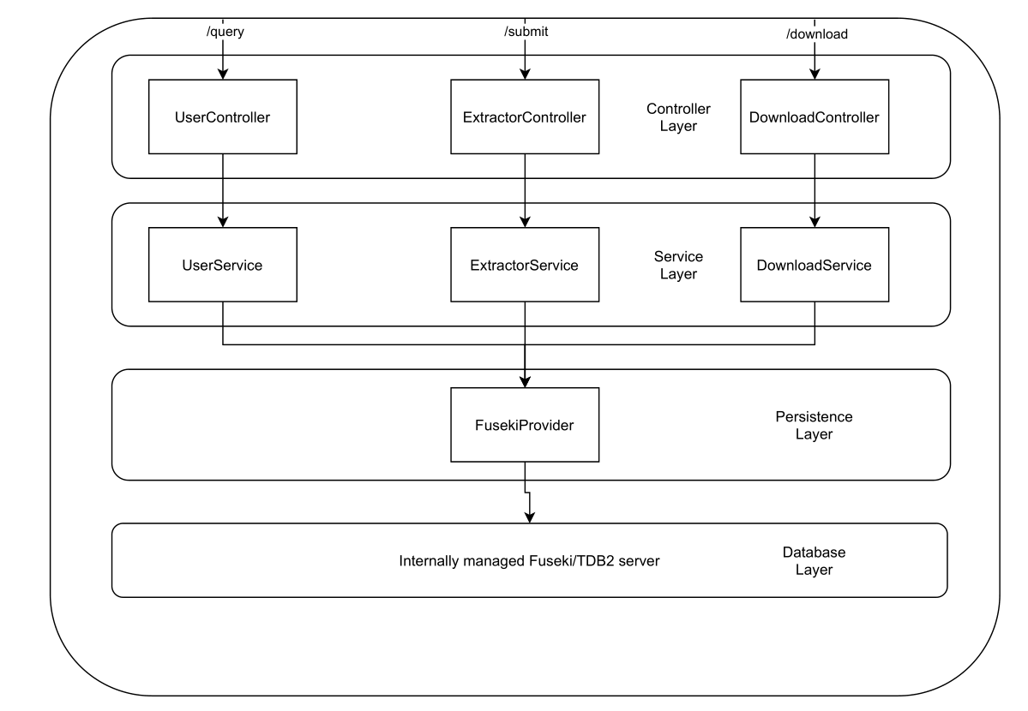
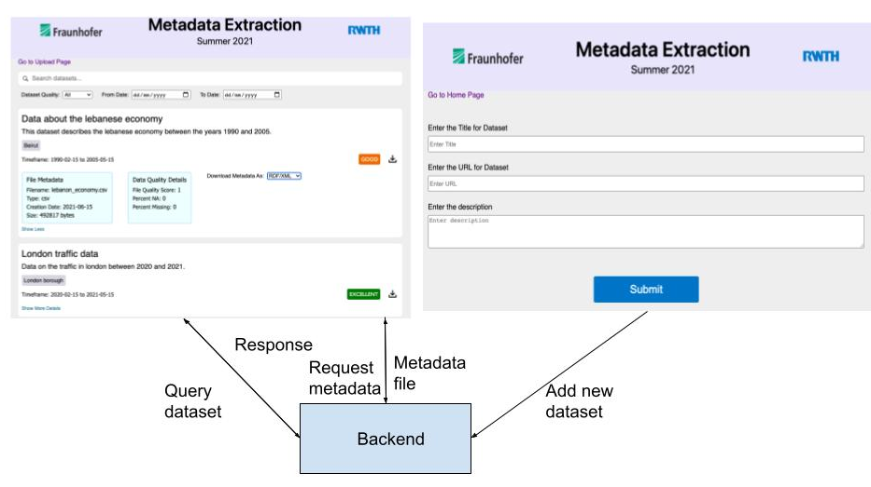
Metadata Extraction
Abhishek Nadgeri¹, Omar Ejjeh²
Lei Wang³, David Abdelsalam⁴, Salman Tariq⁵
Metadata Extraction Overview^{1,2}
Metadata Schema²
Conceptual View of the Metadata Model
Extract metadata from CSV files
Metadata is stored in RDF triplestore
Users can query for relevant datasets based on their metadata
Users can submit new datasets for extraction and integration into the database
Users can download relevant metadata files from the frontend
Uses IDS Information Model to describe datasets
Datasets represented by resources of type ids:TextResource
Included metadata concerns: ids:description, ids:title, ids:keyword, ids:language, ids:resourceEndpoint, ids:temporalCoverage, ids:Representation,
New namespace mdeprops for custom dataquality properties
Dataquality represented using dqv vocabulary
Extractor^{1,3,4,5}
Conceptual View of the Metadata Model
Overview of the extractor architecture
Extractor functionality
Keyword:
Use word2vec and dbpedia lookup to find relevant keywords without further user input
Quality:
Calculate measure of data quality based on missing values etc.
Language:
Use CLD3 to discover the language of the dataset
Timeframe:
For datasets with time column, calculate the timeframe
File metadata:
Use tika to extract filesize, filetype etc.
Backend²
Frontend¹
Conceptual View of the Metadata Model
Conceptual View of the Metadata Model
Overview of the backend architecture
Controller:
One controller per API
Service:
One service per API
Persistence: FusekiProvider initializes and queries database
Database:
Fuseki/TDB2 as database
Query page: allows looking up datasets
based on their
Metadata and down-
loading them
Admin page: allows
users to upload new
datasets

